Slide 1
Solving Problems with a Computer
Computer : A very stupid but very fast device
Algorithm :
An ordered set of simple steps
Processes a set of inputs, returns outputs
Time complexity : Relationship between the number of steps and the size of the inputs

Slide 2
Task 1. Count all even numbers in a list
Inputs : List of numbers
Initialize counter to zero
For each element in the list:
If element % 2 == 0:
Increment counter
Output : Counter

Slide 3
Task 2: Find objects in an image
Inputs :
Image Z (a two-dimensional matrix)
Pattern image P
Tolerance threshold
Result = [ ]
For each row in Z:
For each column in Z:
Compute correlation between submatrix of Z and P
If correlation > threshold:
Add (row, column) to Result

Slide 4
Task 3. Translate a text
Inputs :
Text
Bilingual dictionary
Translation rules (e.g., article + noun + verb → translated(article) + translated(noun) + translated(verb))
For each sentence:
Break into words
Identify and classify words
Find translation rule
Apply rule
Add translated sentence to result
Output : Translated text

Slide 5
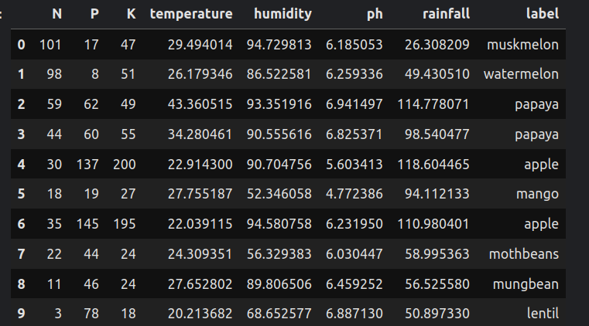
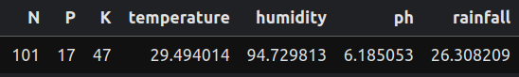
And?
What should I do here?

Slide 6



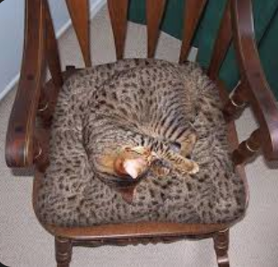

Another example
The more complex the problems we try to solve, the harder it becomes for an expert to define their knowledge in the form of immediately applicable rules.
Example :
How can we recognize a cat in an image?

Slide 7


Slide 8
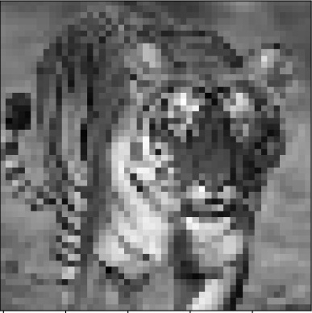

What is in the image?

Slide 9
Problema
When a problem is complex, people often solve it intuitively.
Higher cognitive level.
In such cases, although the result may be correct, explaining the detailed process becomes difficult or even impossible.
The more expert someone is, the worse it gets.
This makes it especially hard to translate that human intuition into explicit rules for a program.
Human intuition does not follow clear and structured algorithms.

